Slide 1
Aging Infrastructure and Energy Efficiency: An Analysis of Building Age Impact on Energy Consumption in Chicago
By
Tejodbhav Koduru
Harishobith Reddy Anantha
Munukutla Durga Venkata Kashyap
(Team 6)

Slide 2
Introduction
Problem Statement: Addressing energy inefficiency in aging urban infrastructures.
Relevance: Crucial for sustainable urban development and reducing environmental footprint.
Primary Objective: Analyze how building age influences energy consumption and efficiency in Chicago.
Impact: Inform policy decisions and practical interventions for energy conservation.
Notes:
Introduction to the Problem:
• “Let’s start with why this project matters. Cities like Chicago face significant challenges in managing energy consumption and efficiency, especially within older buildings that form a substantial portion of the urban landscape. Our study focuses on understanding how the age of these buildings impacts their energy usage and efficiency levels.”
Discussing Relevance:
• “This research is particularly relevant as it aligns with global and local sustainability goals. By identifying energy inefficiency factors in older infrastructure, we can contribute to the broader agenda of reducing the environmental impact of urban areas, thereby supporting efforts towards achieving a more sustainable future.”
Explanation of Objectives:
• “The primary objective of our project is to meticulously analyze the relationship between building age and key energy performance metrics across various types of properties in Chicago. We aim to uncover patterns and provide insights that can help in shaping more effective energy policies and renovation practices.”
Impact on Policy and Practice:
• “The insights gained from our analysis are expected to help policymakers and urban planners understand where to focus energy conservation efforts. By pinpointing which building ages and types are most prone to energy inefficiency, our findings could guide targeted retrofitting initiatives and influence new regulations to improve building energy performance.”

Slide 3
Hypothesis
Primary Hypothesis: Older buildings tend to have higher energy use and lower energy efficiency scores compared to newer buildings due to outdated construction and systems.
Secondary Hypothesis: There is a significant yearly improvement in energy efficiency metrics across all buildings, reflecting the cumulative impact of ongoing energy conservation measures and advancements in building technologies.
Notes:
Introduction to Hypotheses:
• “Our study is guided by two focused hypotheses, which are designed to uncover the impacts of building age and temporal changes in energy efficiency in Chicago’s urban landscape.”
Detailing Primary Hypothesis:
• “The primary hypothesis explores the intrinsic challenges of older buildings which often include outdated construction materials and older systems, leading to higher energy consumption and lower efficiency scores. This part of our analysis seeks to highlight specific age-related inefficiencies that can target retrofitting efforts.”
Explaining Secondary Hypothesis:
• “Our secondary hypothesis shifts the lens to the temporal aspect of our study. We hypothesize that across the dataset, irrespective of building age, there will be a noticeable improvement in energy efficiency metrics year-over-year. This hypothesis aims to capture the effectiveness of broader energy conservation initiatives that have been progressively implemented over the years, including technological advancements and changes in energy regulations.”
Importance of These Hypotheses:
• “Together, these hypotheses will allow us to dissect both static and dynamic factors affecting energy efficiency. Validating these hypotheses not only provides insights into the current state of energy efficiency in Chicago but also assists in forecasting future trends and planning more effective energy policies.”
Transition to Next Section:
• “Armed with these hypotheses, let’s now delve into the rich dataset we’ve compiled, detailing how we’ve prepared it to test these assumptions comprehensively.”

Slide 4
Data Overview
Dataset: Energy Consumption Data
Source: Chicago Energy Benchmarking
Resolution: Detailed property-level data, allowing for precise analysis of energy metrics within specific locations.
Data Points: 24,891 entries.
Parameters:
Data Year: The collection year for the data.
Property Name and ID: Identifiers for specific properties.
ZIP Code and Community Area: Geographic identifiers.
Energy Ratings: Ratings including Chicago Energy ratings and exemptions.
Gross Floor Area: Property sizes in square feet.
Electricity Use: Detailed consumption figures in kBtu.
Gas Use: Detailed consumption figures in kBtu.
ENERGY STAR Score: Ratings reflecting energy efficiency.
GHG Emissions: Total greenhouse gas emissions in metric tons of CO2 equivalent.
Site and Source EUI: Energy Use Intensity per square foot at the site and from all energy sources.
Latitude and Longitude: Coordinates for spatial analysis.
Notes:
Introducing the Data:
• “To achieve the objectives of our study, we’ve compiled a comprehensive dataset that serves as the backbone of our analysis. This data has been sourced responsibly from reliable public records and specialized energy databases that track building performance metrics across Chicago.”
Discussing Key Metrics:
• “The variables we focus on include the Year Built, which helps us categorize buildings by age; Energy Use in kBtu, which gives us absolute figures on energy consumption; the ENERGY STAR Score, a benchmark for energy efficiency; and both Site and Source Energy Use Intensity, or EUI, which provide insights into energy consumption per square foot. We also look at Total Greenhouse Gas Emissions to understand environmental impacts, and Gross Floor Area to account for size differences in our analysis.”
Detailing Data Volume and Preparation:
• “Our dataset encompasses data for about 1,000 buildings, covering four key years—2018, 2020, 2021, and 2022. This timeframe allows us to observe both immediate and evolving trends. In preparing this data for analysis, we’ve standardized formatting, addressed any missing values, and conducted thorough checks to ensure accuracy, allowing us to proceed with analyses that we can stand behind confidently.”
Implication of the Data Setup:
• “The robustness and comprehensiveness of our dataset are crucial. They not only allow us to perform detailed historical analysis but also to make informed predictions about energy efficiency trends. This data will enable us to test our hypotheses rigorously and provide reliable, evidence-based recommendations for energy conservation strategies tailored specifically to Chicago’s unique urban landscape.”

Slide 5
Analytical Methodology
Data Handling: Standardize, clean, and preprocess data to ensure accuracy and consistency.
Statistical Analysis:
Regression Analysis to explore the relationship between building age and energy efficiency metrics.
Time Series Analysis to identify trends in energy efficiency over the selected years.
Comparative Analysis:
Examine differences in energy performance between older and newer buildings.
Analyze year-over-year improvements across the building dataset.
Software and Tools Used:
Python for data manipulation and statistical/ML modeling.
GIS technology for any spatial analysis related to building locations.
Notes:
Introduction to Methodology:
• “Now, let’s discuss the methodologies that underpin our analysis. This framework is designed to rigorously test our hypotheses and ensure our findings are both robust and actionable.”
Detailing Data Handling:
• “Firstly, our approach begins with meticulous data handling. We standardize, clean, and preprocess our dataset to ensure that the data we analyze is accurate and consistent. This step is fundamental to producing reliable results.”
Explaining Statistical Analysis:
• “For our statistical analysis, we utilize regression techniques to assess how the age of a building affects its energy efficiency, looking for statistical significance in these relationships. Additionally, we employ time series analysis to track and forecast trends in energy efficiency across the years covered by our study.”
Discussing Comparative Analysis:
• “Comparative analysis plays a crucial role in our methodology. We compare older buildings to newer ones to identify any significant differences in energy performance. This helps us understand the real-world impact of aging infrastructure on energy efficiency. We also look at improvements over time to evaluate the effectiveness of recent energy conservation measures.”
Software and Tools:
• “To accomplish this, we leverage various tools. Python, with its powerful libraries, assists us in data manipulation and modeling, while R provides us with the capability for conducting sophisticated statistical tests. For any spatial elements in our data, we utilize GIS technology, allowing us to analyze the geographical aspects of building energy efficiency.”
Concluding Methodology Section:
• “This comprehensive methodological approach ensures that we can provide detailed insights into the energy performance of Chicago’s buildings, with a clear focus on how both time and technology influence energy efficiency.”

Slide 6
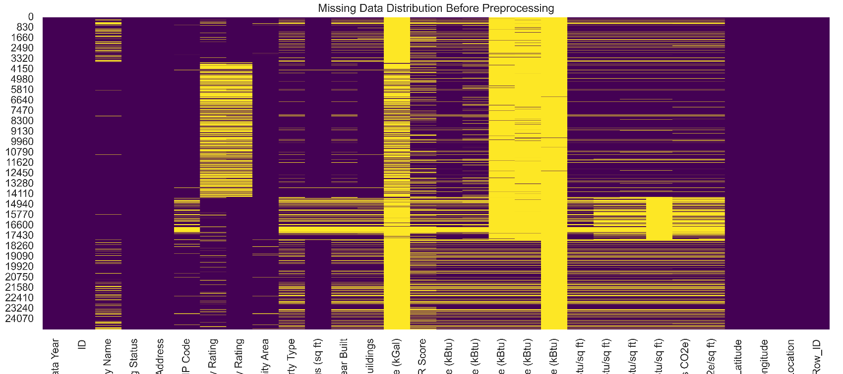
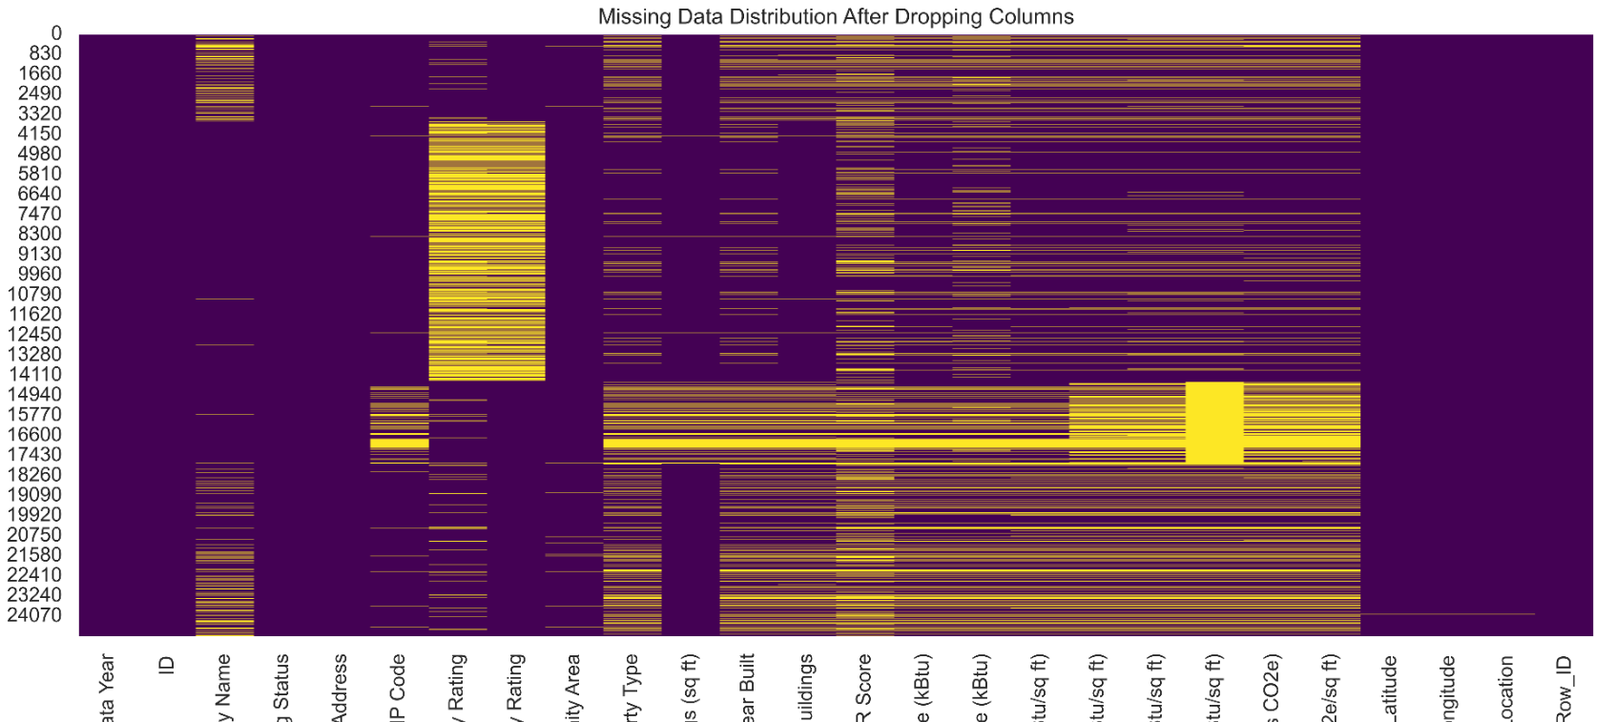
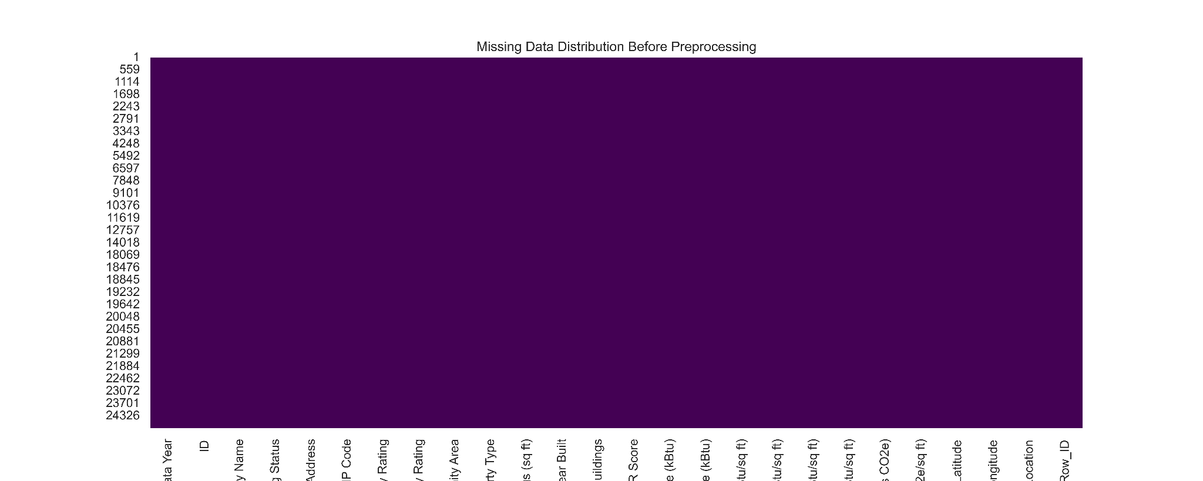
Data Preprocessing
Identified and visualized missing data across all variables.
Dropped columns with excessive missing data to refine dataset.
Dropped all rows containing any missing values to ensure analysis robustness.
No Missing Data
Notes:
• Introduction to Data Issues:
• “In our project, maintaining data integrity was paramount. The initial state of our dataset revealed significant missing data across various fields, depicted in the first visualization.”
• Discussing Column Removal:
• “Our first step in the cleaning process was to identify and remove columns with excessive missing data, which could compromise our analysis. This step helped us focus on more complete and reliable metrics, as shown in the second visualization.”
• Detailing Row Removal:
• “Following column removal, our approach to handling remaining missing data was straightforward: we removed any rows that still contained missing values. The third visualization shows the cleaned dataset, now devoid of missing data, ensuring that our subsequent analyses are based on complete records only.”
• Relevance to Hypotheses Testing:
• “This rigorous data cleaning ensures that our testing of the hypotheses regarding building age and energy efficiency is based on the most accurate data possible. It’s crucial for our analysis that we avoid the potential biases or errors that missing data could introduce.”
• Transition to Next Section:
• “With a clean and reliable dataset in place, we will next outline the statistical techniques we used to analyze these data and explore the dynamics of energy efficiency across Chicago’s buildings.”

Slide 7
Data Preprocessing
New Feature: Building Age – Created by subtracting the year the building was built from the current year to understand the impact of building age on energy performance.
New Feature: Building Category – Segregated buildings into categories based on Building Age.
Data Formatting Adjustments:
Converted Year Built and Energy Efficiency Metrics to appropriate numeric formats for analysis.
Standardized ZIP Code as string format to ensure consistency in spatial analysis.
Notes:
• Introduction to Data Issues:
• “In our project, maintaining data integrity was paramount. The initial state of our dataset revealed significant missing data across various fields, depicted in the first visualization.”
• Discussing Column Removal:
• “Our first step in the cleaning process was to identify and remove columns with excessive missing data, which could compromise our analysis. This step helped us focus on more complete and reliable metrics, as shown in the second visualization.”
• Detailing Row Removal:
• “Following column removal, our approach to handling remaining missing data was straightforward: we removed any rows that still contained missing values. The third visualization shows the cleaned dataset, now devoid of missing data, ensuring that our subsequent analyses are based on complete records only.”
• Relevance to Hypotheses Testing:
• “This rigorous data cleaning ensures that our testing of the hypotheses regarding building age and energy efficiency is based on the most accurate data possible. It’s crucial for our analysis that we avoid the potential biases or errors that missing data could introduce.”
• Transition to Next Section:
• “With a clean and reliable dataset in place, we will next outline the statistical techniques we used to analyze these data and explore the dynamics of energy efficiency across Chicago’s buildings.”

Slide 8
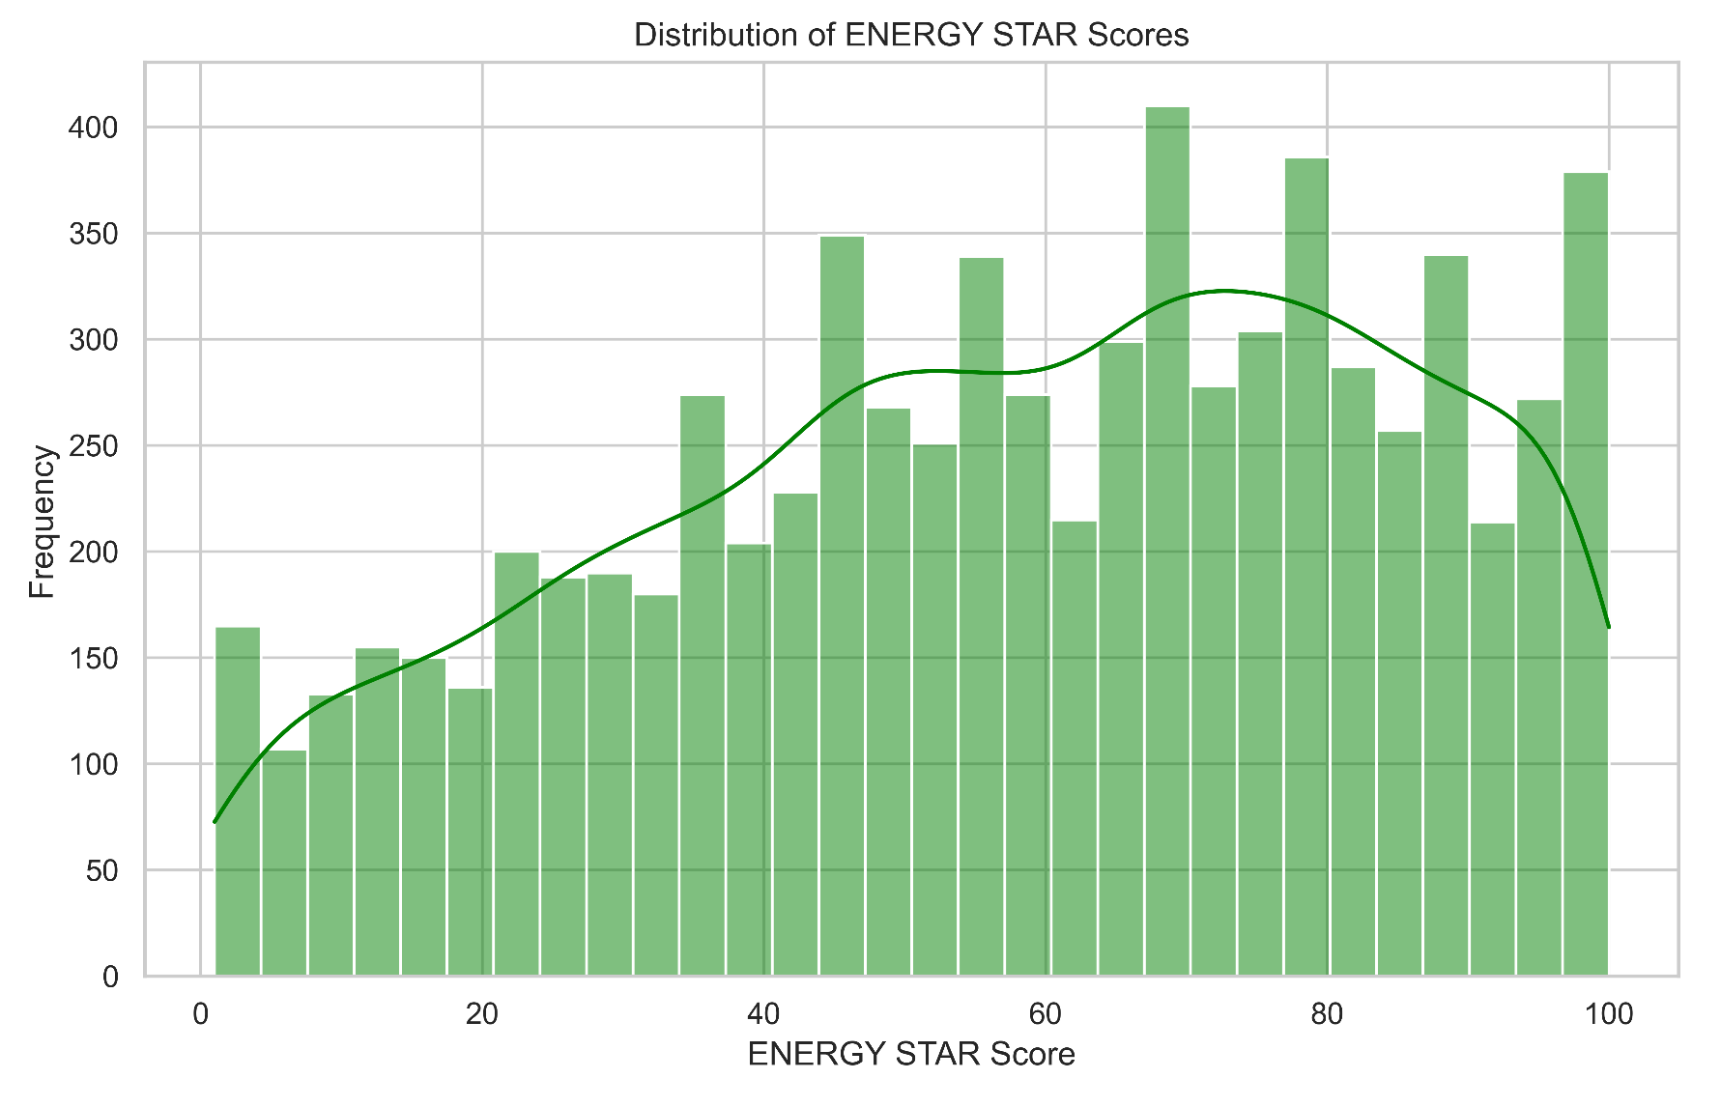
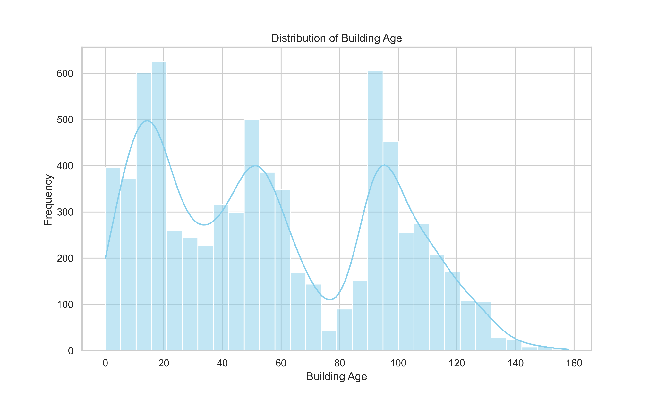
Intermediate Results

Slide 9
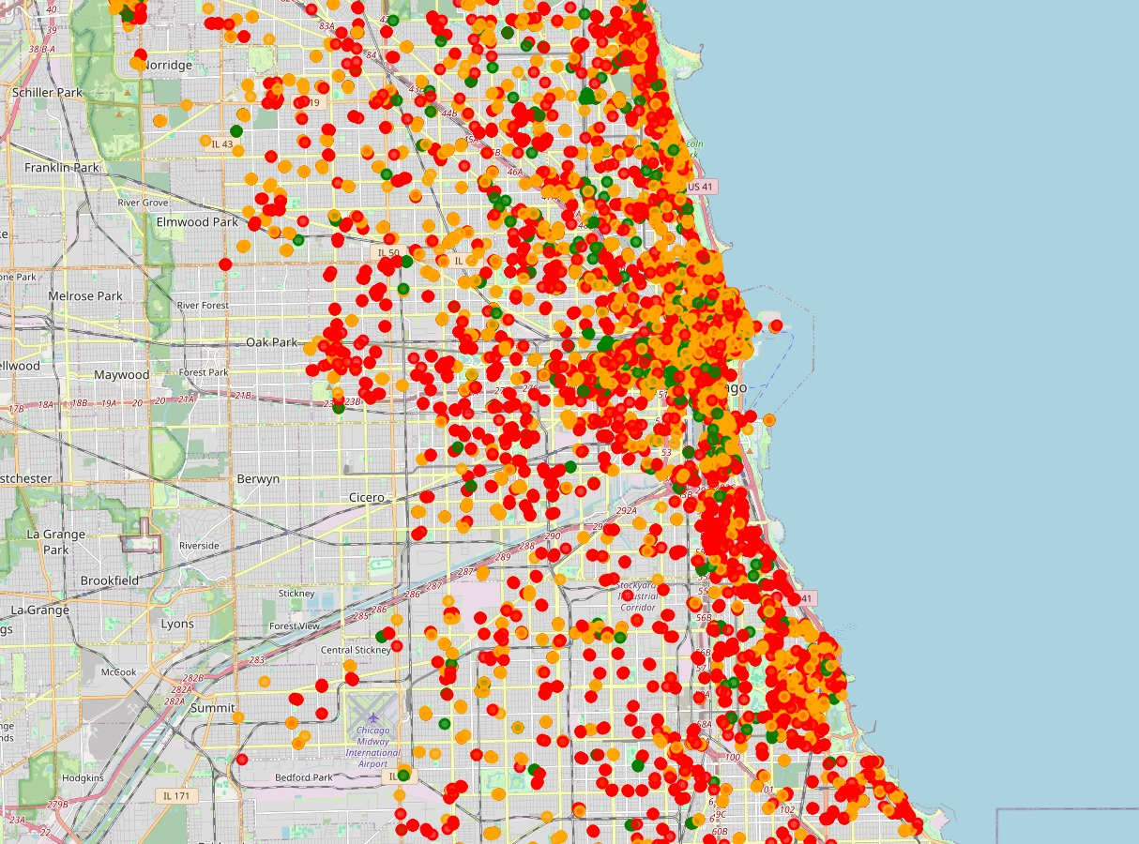
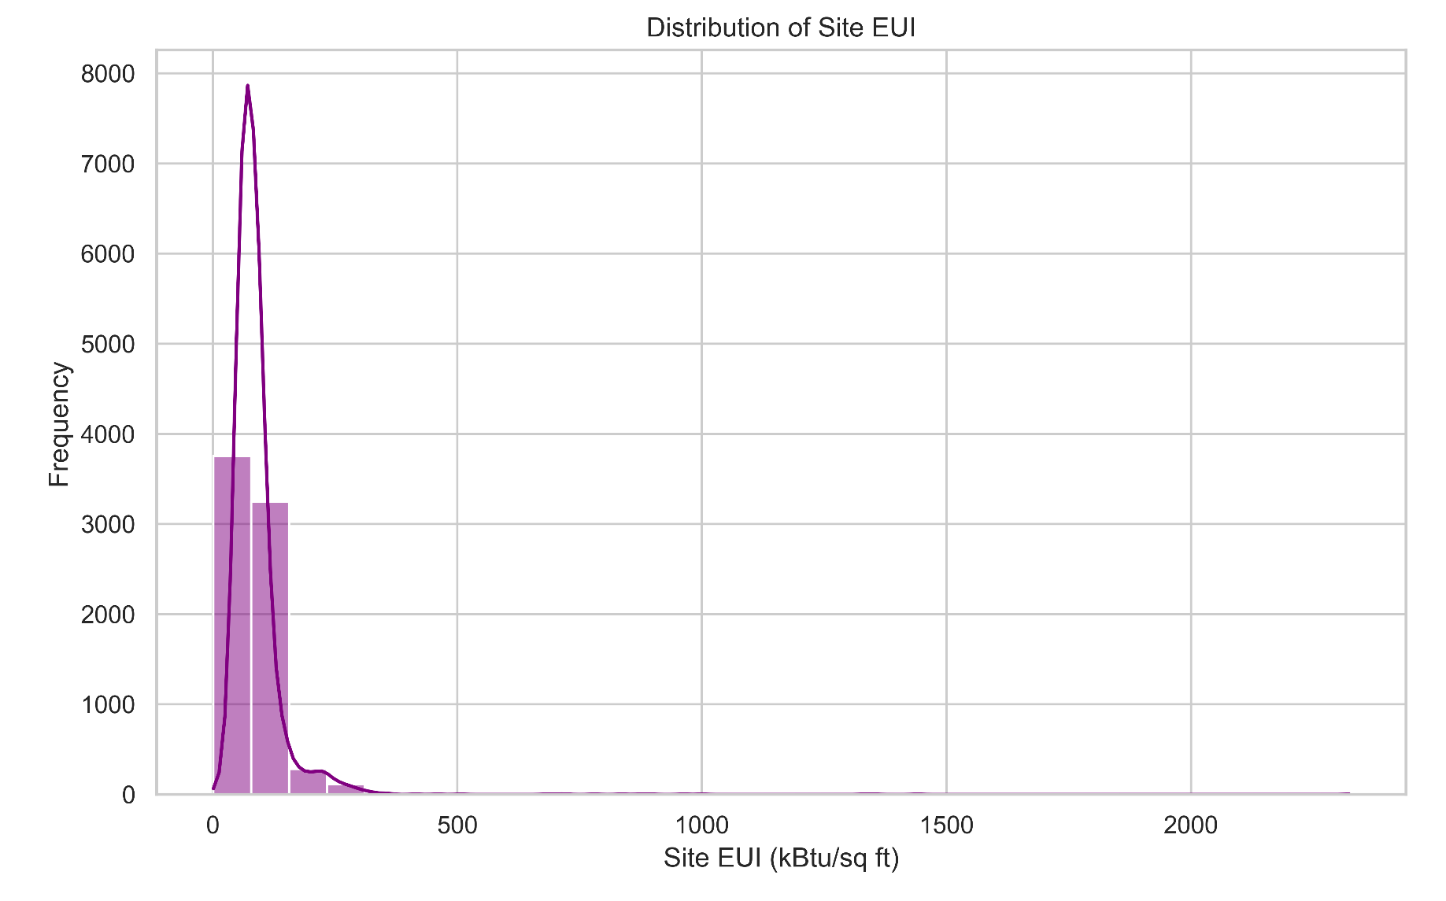
Intermediate Results
EUI < 50
EUI < 100
EUI > 100
Site EUI (kBtu/sq ft)

Slide 10
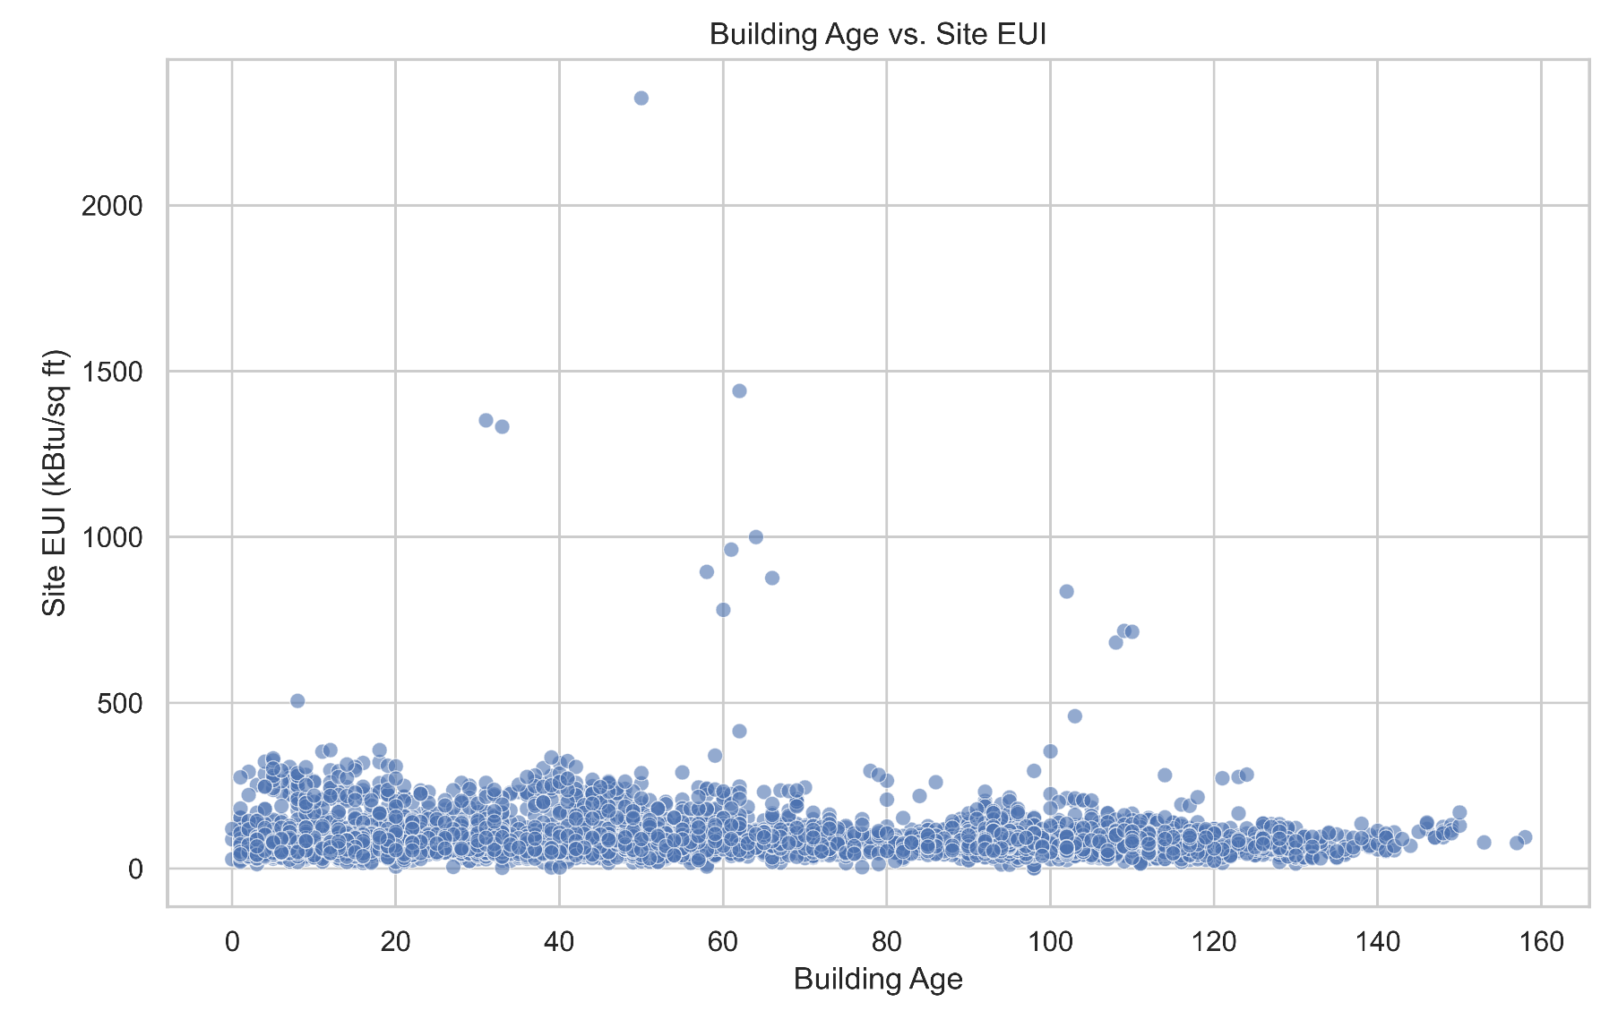
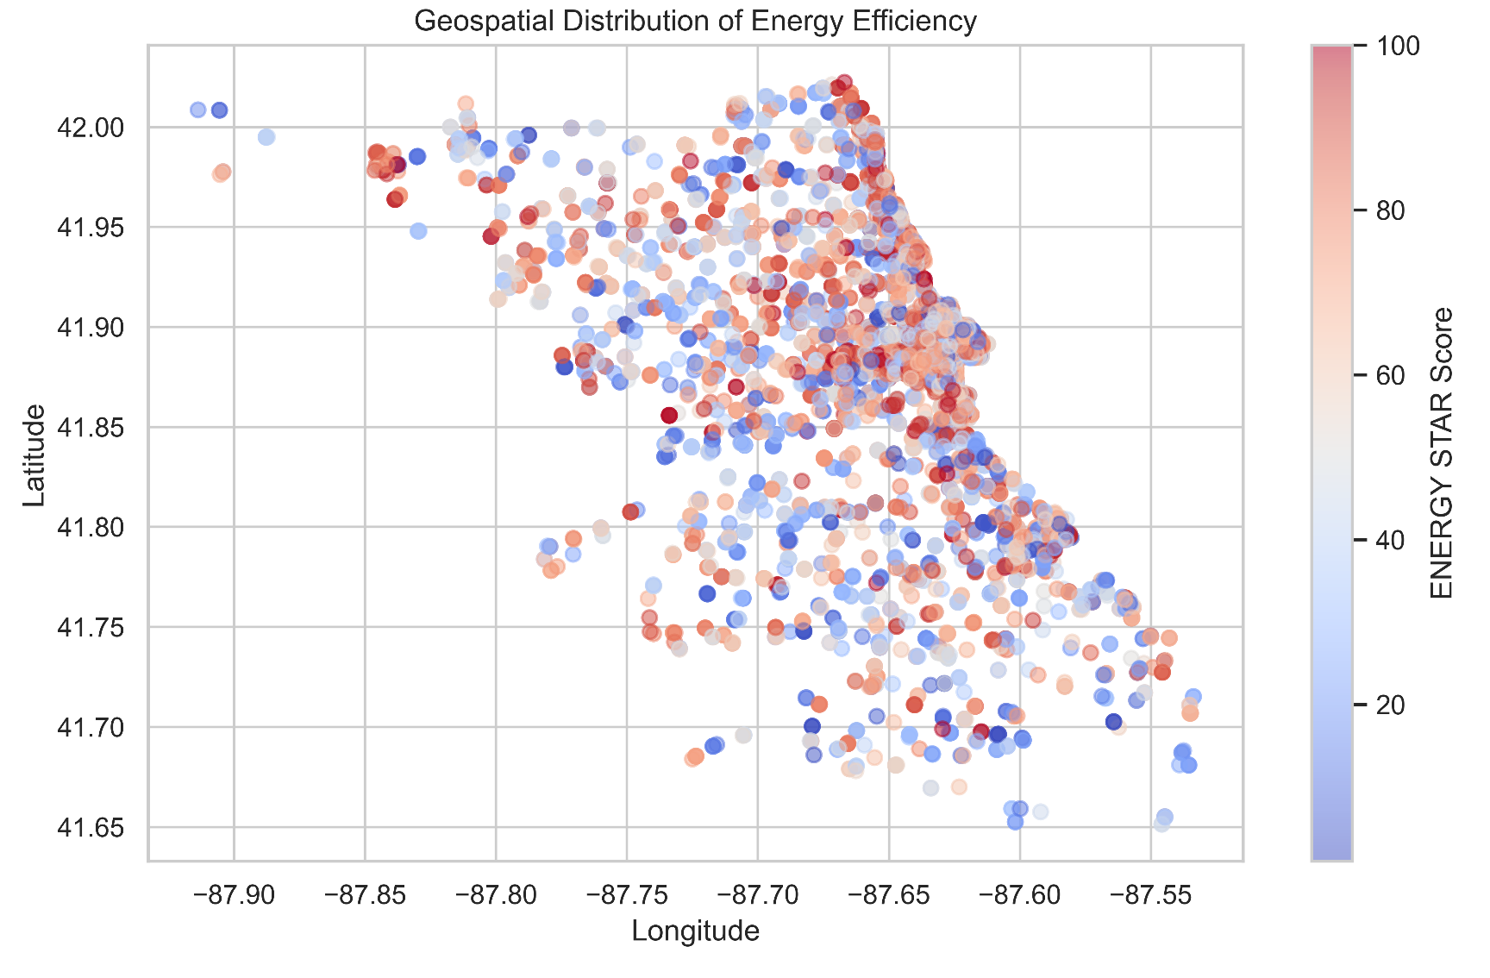
Intermediate Results

Slide 11
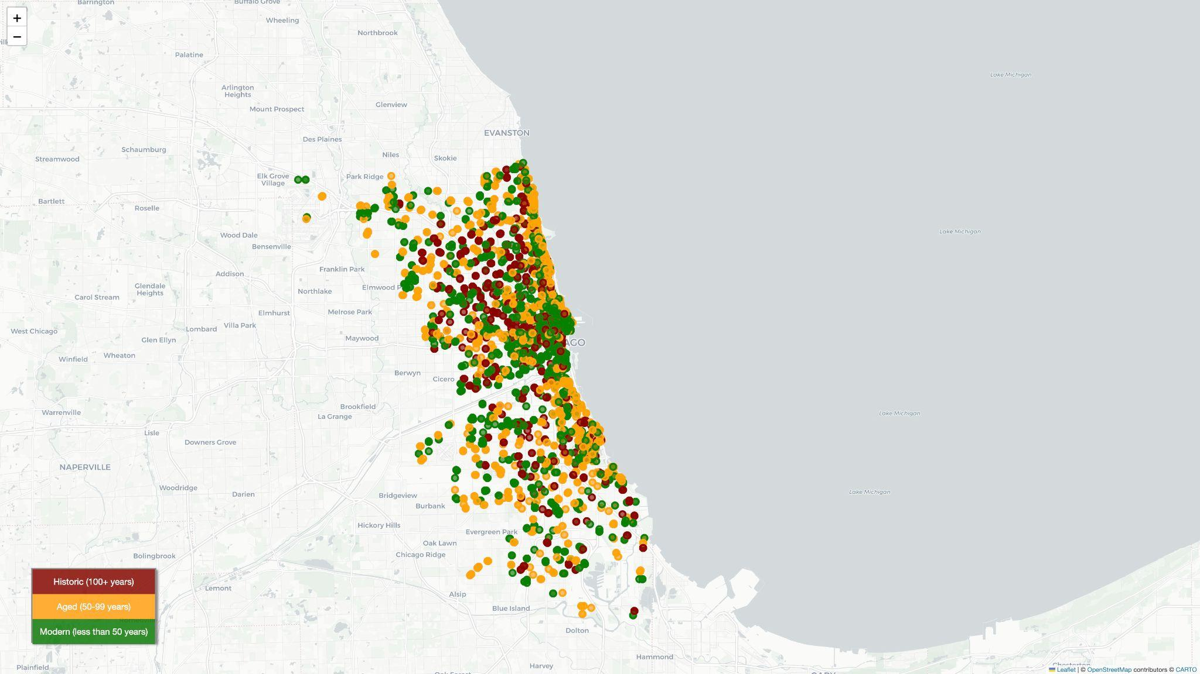
Intermediate Results
Building Age

Slide 12
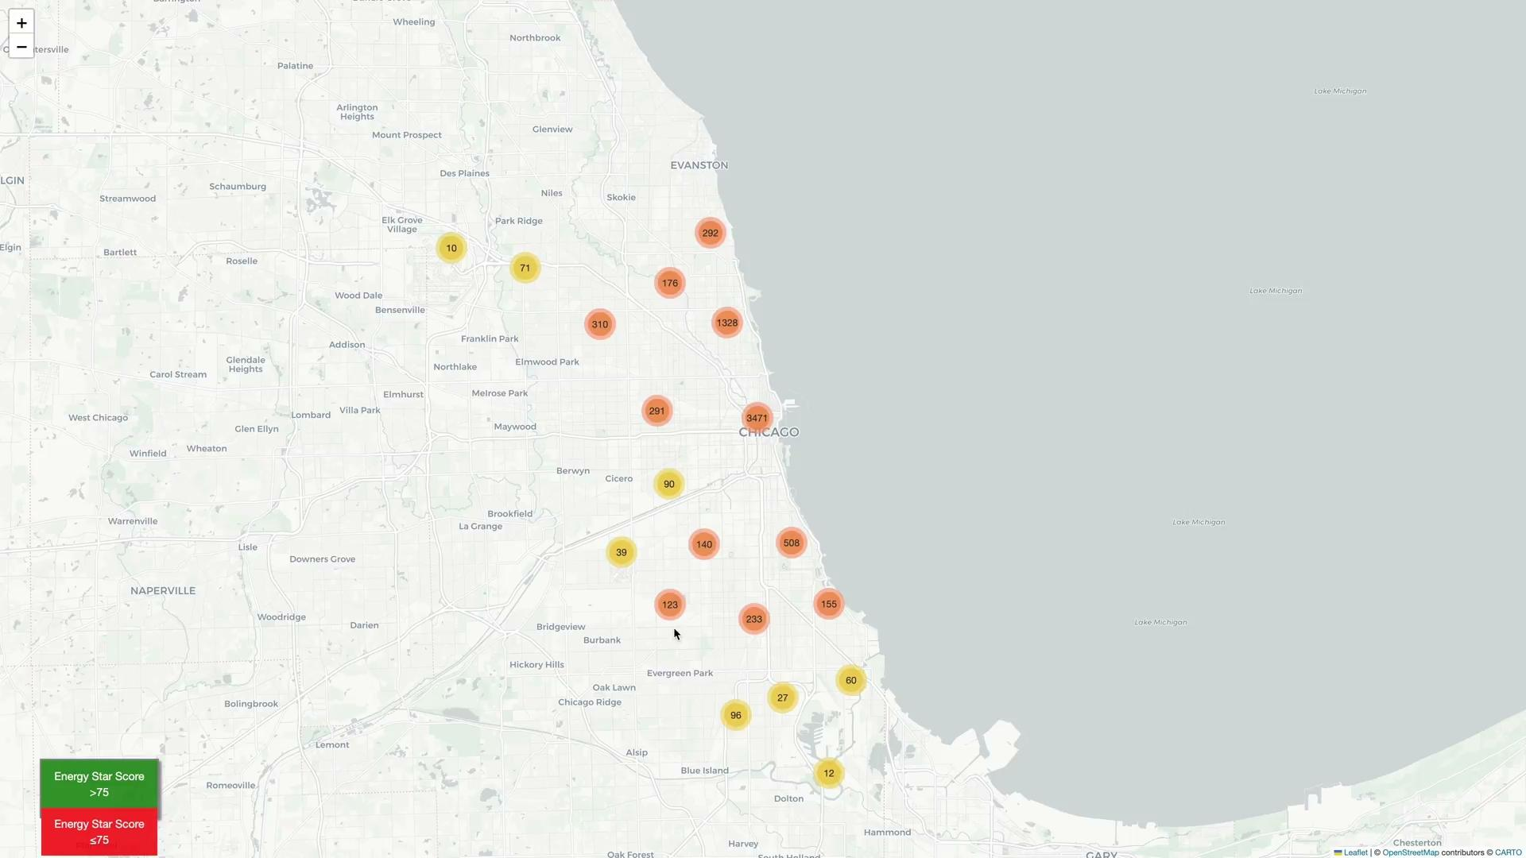
Intermediate Results
Energy Star Ratings

Slide 13
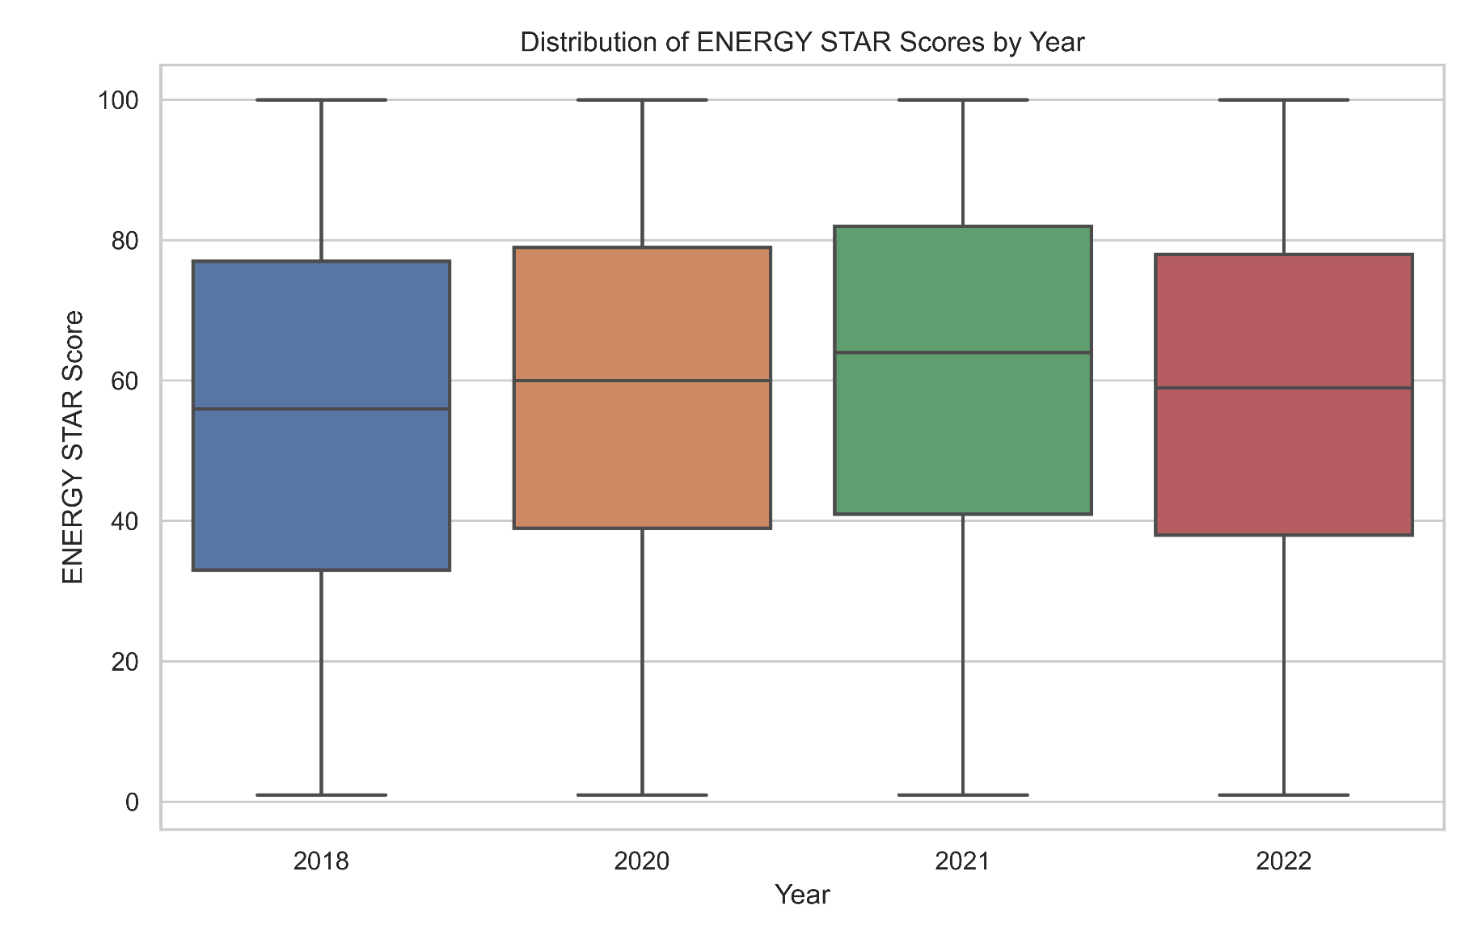
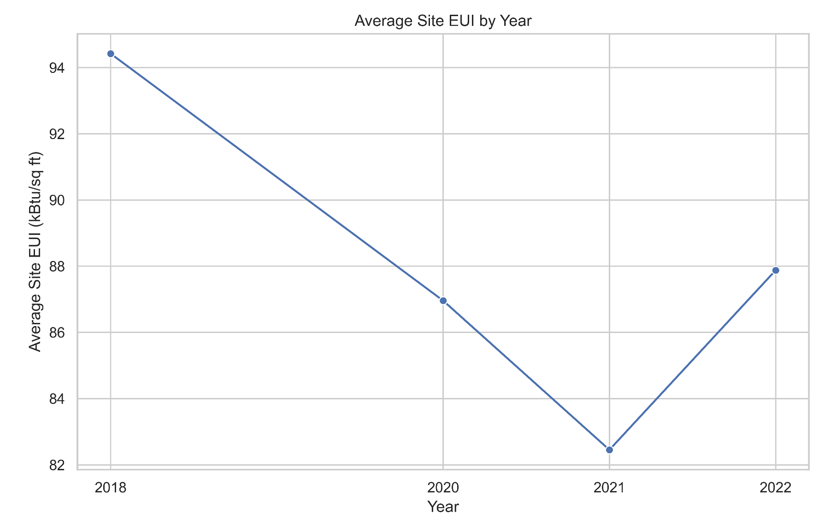
Intermediate Results

Slide 14
Next Steps
Deeper Time Series Analysis: Perform time series analysis on energy performance trends from 2018 to 2022 to better understand long-term changes in energy efficiency.
Retrofit Impact Investigation: Investigate specific cases of older buildings with low energy use to identify successful retrofitting strategies.
Expand Spatial Analysis: Refine the geospatial analysis to explore neighborhood-level energy trends and identify key geographic drivers of efficiency.
Building Type Segmentation: Analyze energy efficiency patterns based on building types (residential, commercial, industrial) to gain more granular insights.
Future Data Preprocessing Enhancements: Plan to revisit data preprocessing to explore imputation techniques for missing values instead of removing rows, ensuring more comprehensive data use once our analysis framework is fully operational.
Notes:
Coming to Next Steps:
• “As we move forward, there are several next steps that will allow us to deepen our analysis and refine our findings.”
Discussing Time Series Analysis:
• we plan to conduct a more detailed time series analysis to observe trends in energy performance across the years. This will help us capture long-term improvements or deterioration in energy efficiency and link them to policy or technological changes.”
Retrofit Impact Investigation:
• “We’ll also investigate older buildings that exhibit lower energy use. This will help us identify retrofitting strategies or operational practices that contribute to higher efficiency and can be applied to other older buildings.”
Expanding Spatial Analysis:
• “Our geospatial analysis will be expanded to examine energy trends at the neighborhood level, allowing us to identify local drivers of energy efficiency and inform localized energy policies.”
Building Type Segmentation:
• “We will segment our analysis by building type, such as residential, commercial, and industrial, to identify specific energy patterns within each category. This will allow us to provide tailored recommendations based on building use.”
Future Data Preprocessing:
• “Finally, in the future, we plan to revisit the data preprocessing step to experiment with imputing missing values instead of removing them. This will allow us to retain more data and potentially improve the accuracy of our analysis once we’ve confirmed the overall framework is working well.”
Closing Remarks:
• “These next steps will enable us to build on the current findings and refine our approach, providing even more targeted insights for enhancing energy efficiency across Chicago.”

Slide 15
Conclusion
Our analysis of building age, energy efficiency scores, and geographic trends reveals several important insights. While most buildings in Chicago achieve moderately high ENERGY STAR scores, there is significant variability, indicating a mix of both highly efficient and inefficient structures. Geographic disparities in energy efficiency further suggest that local factors, such as policy initiatives and infrastructure development, heavily influence performance.These findings underscore the need for targeted strategies that address both the variability in building efficiency and the geographic inequalities.
Notes:
Our analysis reveals key insights into building energy performance in Chicago. While most buildings achieve moderately high ENERGY STAR scores, there is significant variability, with a mix of both efficient and inefficient structures. Additionally, we found clear geographic disparities in energy efficiency, indicating that local factors like policy and infrastructure play a major role in performance.
These findings suggest the need for targeted strategies to address both the variability in building efficiency and geographic inequalities. Tailored interventions, such as retrofitting and policy adjustments in underperforming areas, can help create a more balanced and energy-efficient city.

Slide 16
THANK YOU

